Slide 1
Analysis of GDP (1997-2020)
Shashank Gubba
(SID: 110288232)

Slide 2
Data cleaning
Tools used for data cleaning and modifying.
Analysis using r
Different visualizations of the data using R and its libraries
Analysis using Power bi
Data cleaning process and visualization using PowerBI
Analysis using tableau
Different kinds of visualizations using Tableau

Slide 3
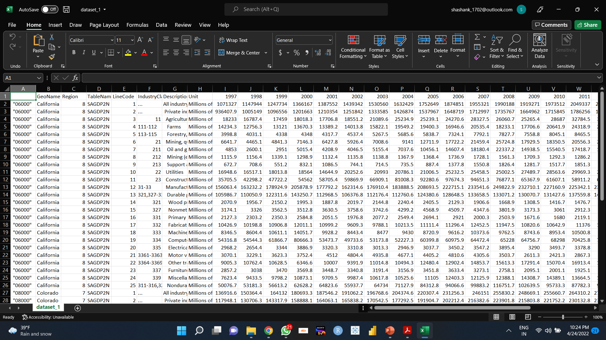
Data cleaning
Excel as been used for the data cleaning initially.
All the null values and unwanted values have been eliminated.
All the data cleaning is done manually.

Slide 4
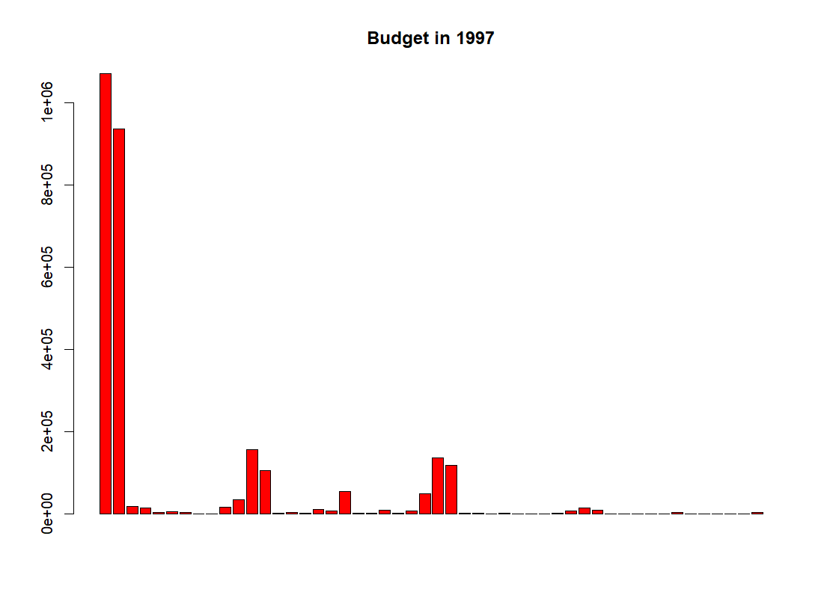
Analysis using r
Different graphs using R has been made.
Graphs following a 5-year trend have been made and analysed

Slide 5
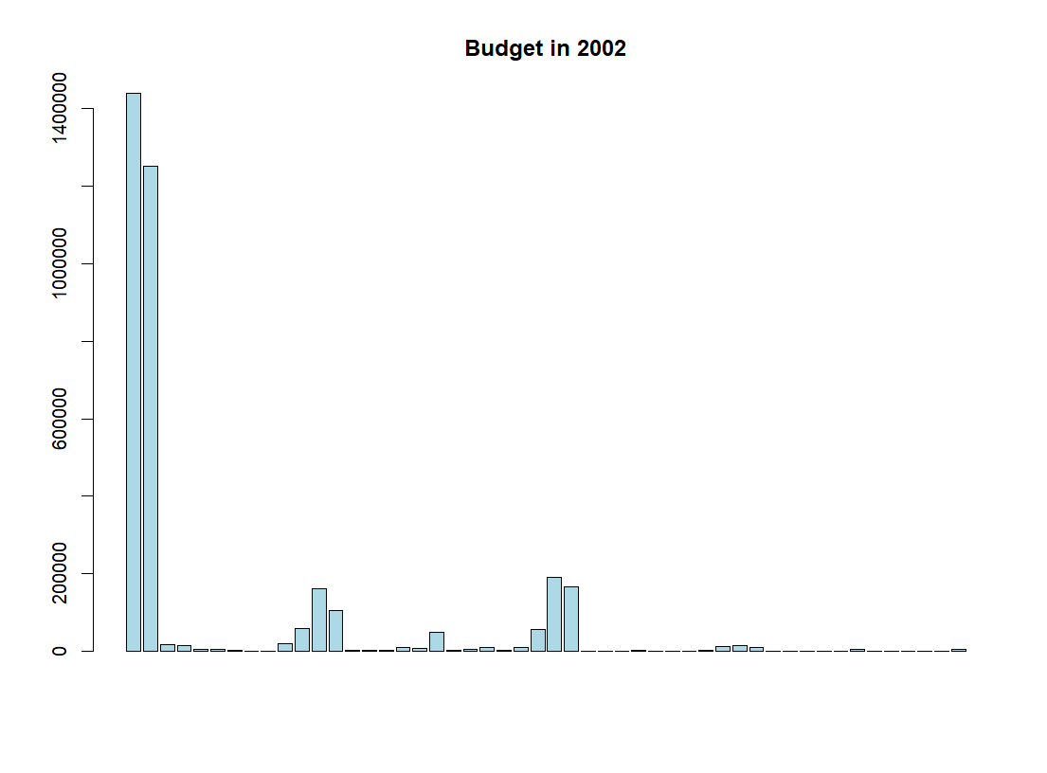
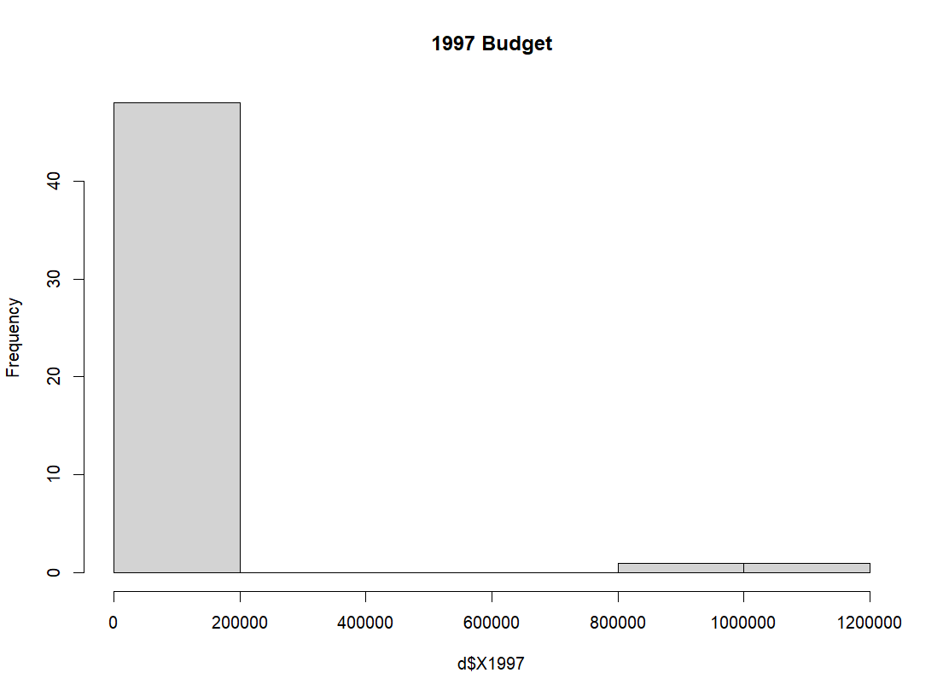
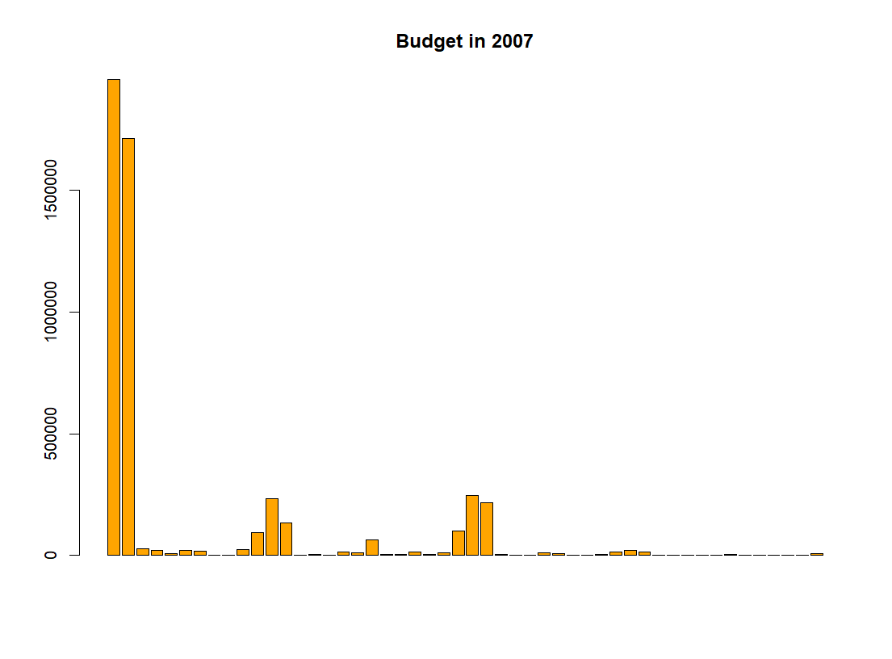
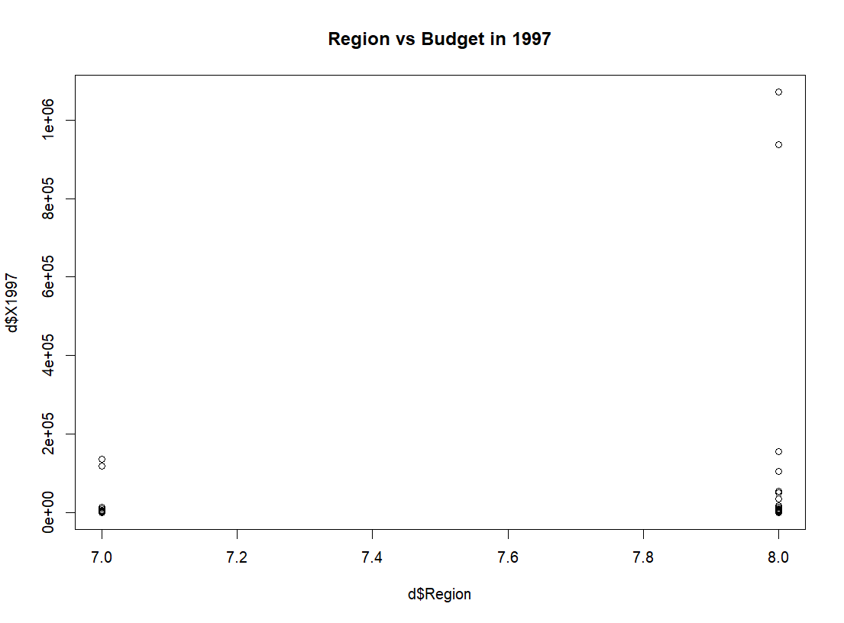
All other graphs that are made using R are shown above.
After observing we can say that there is not much change in the expenditure.

Slide 6
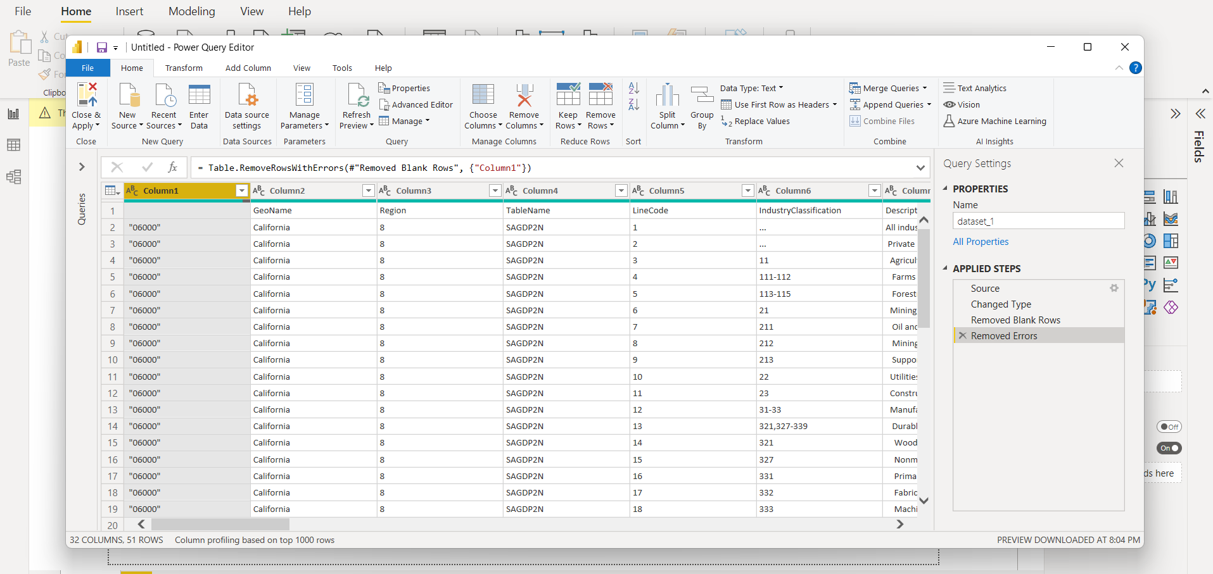
Analysis using powerbi
The above picture shows how data cleaning is done using Power query editor in PowerBI.
Numerous graphs are made using PowerBI for the analysis.
In PowerBI, all the visualizations can be seen all together at the dashboard.

Slide 7
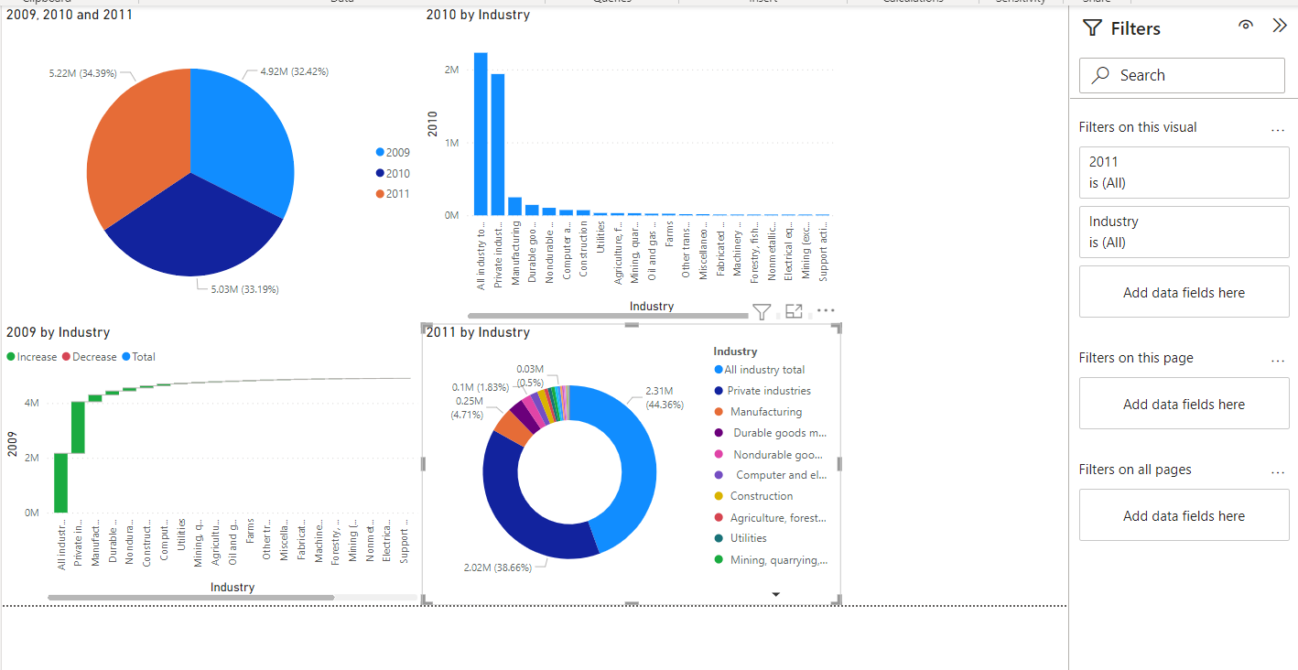
POWERBI DASHBOARD
All the visualizations give information about expenditure in different years.
Pie chart gives information about expenditure of all industries in 2009, 2010 and 2011.
Bar chart gives info of expenditure in 2010.
Donut chart gives info about expenditure in 2011.

Slide 8
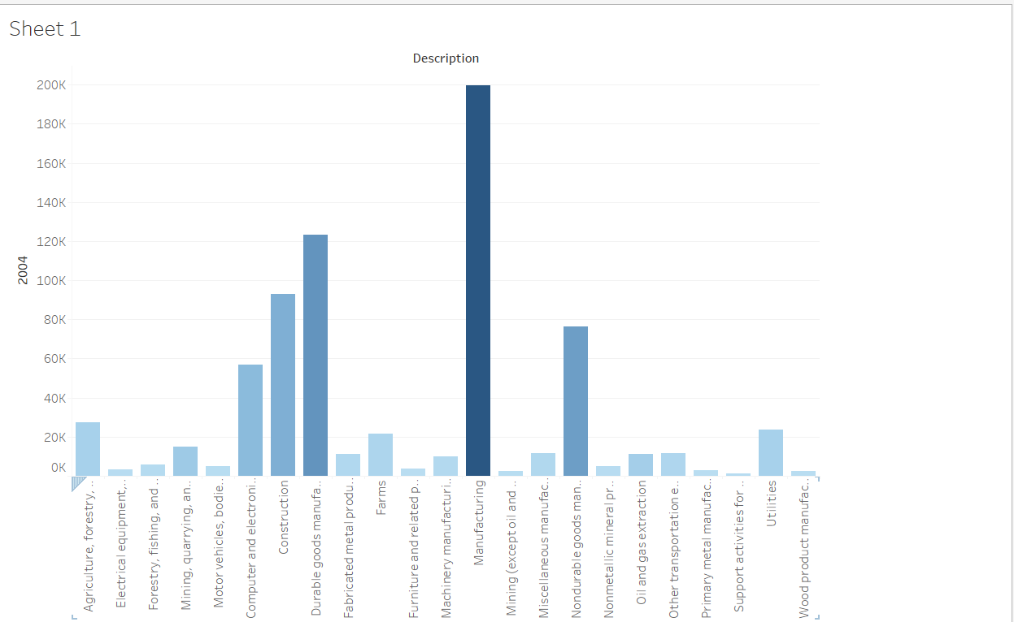
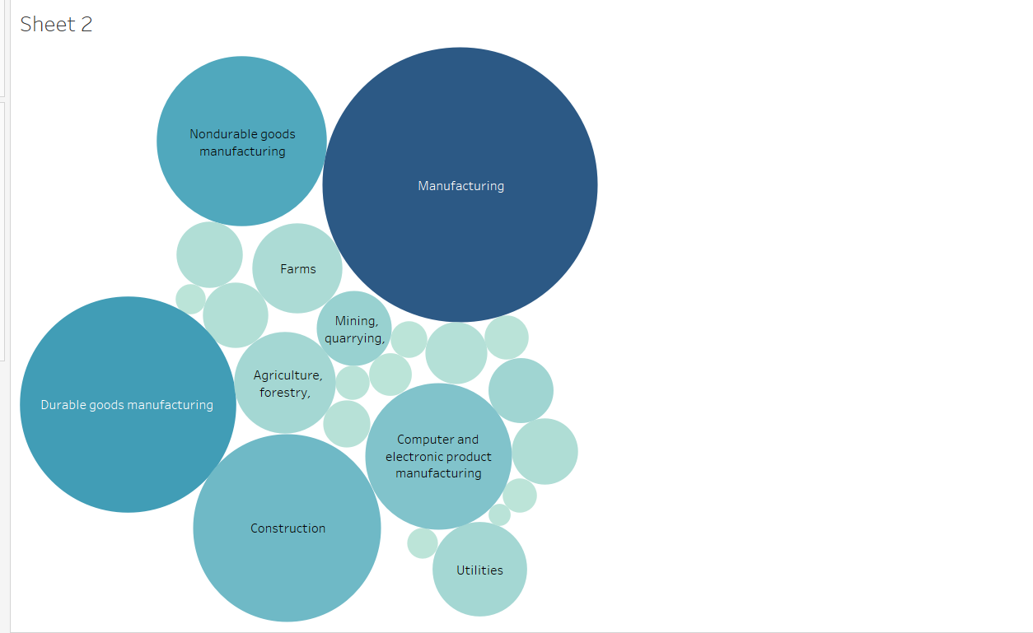
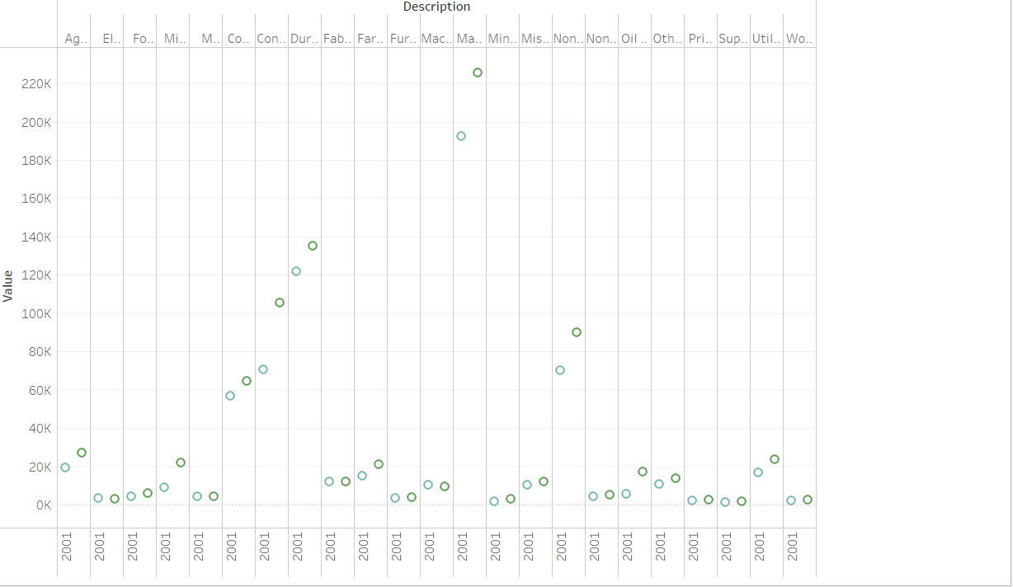
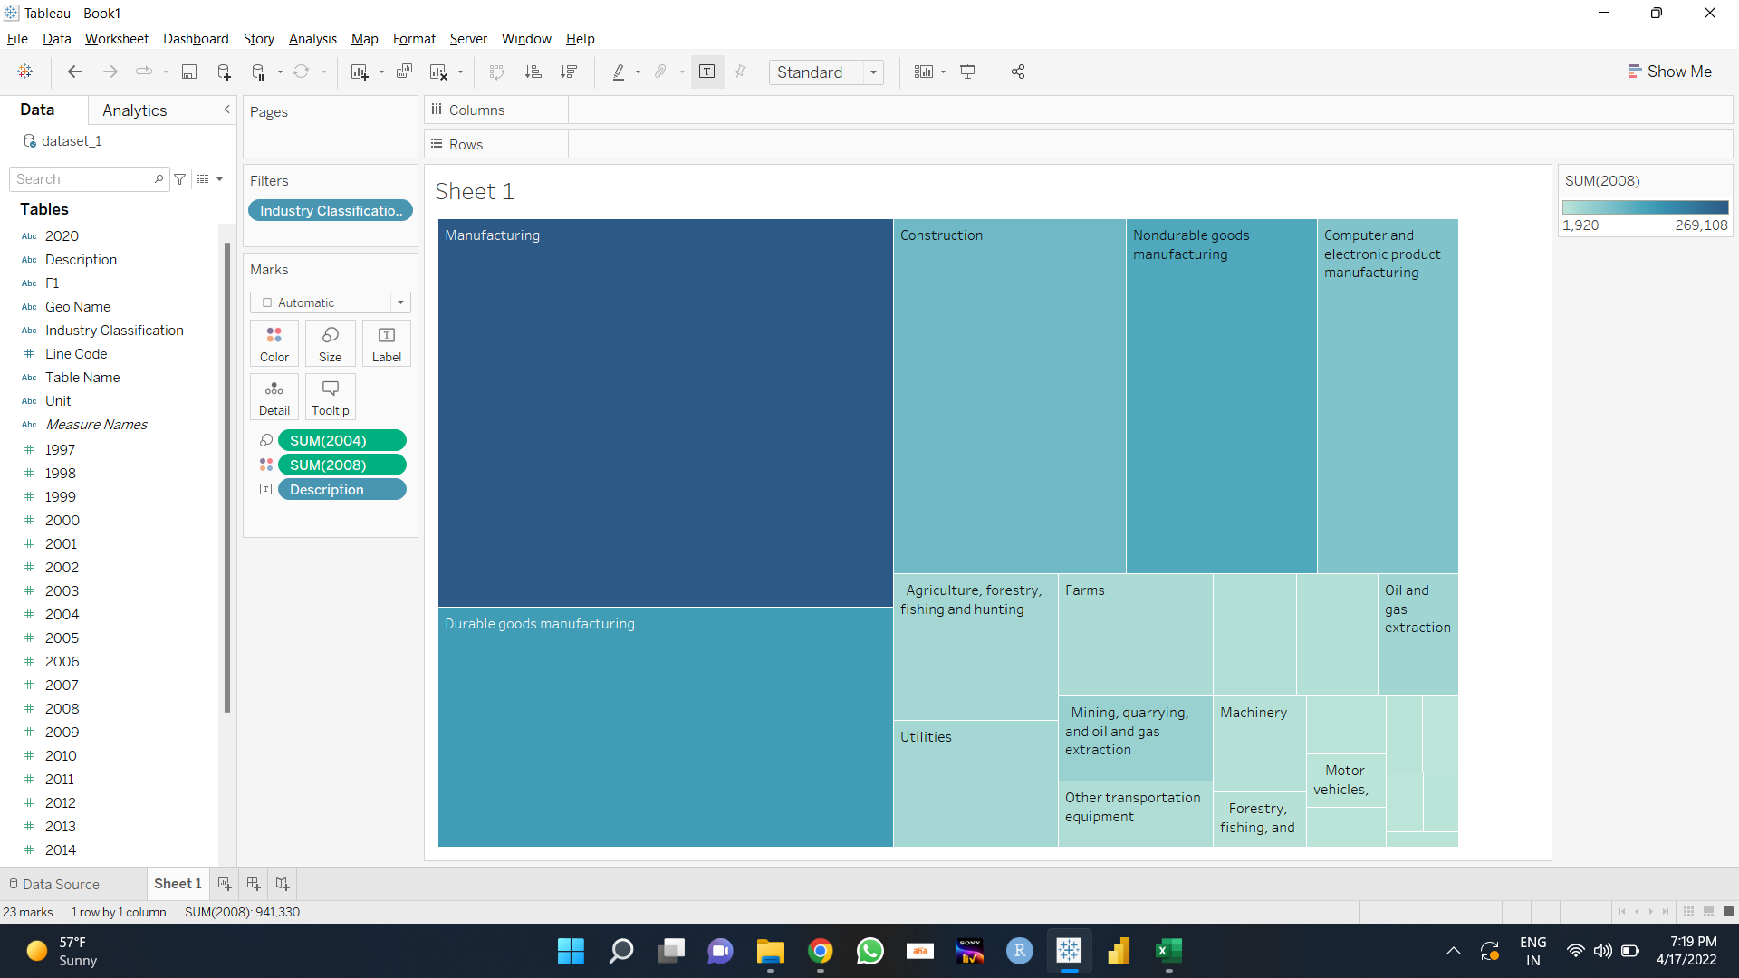
Analysis using tableau
All the graphs made using Tableau have been shown above.
Each visualization gives information about different parameters of the dataset.

Slide 9
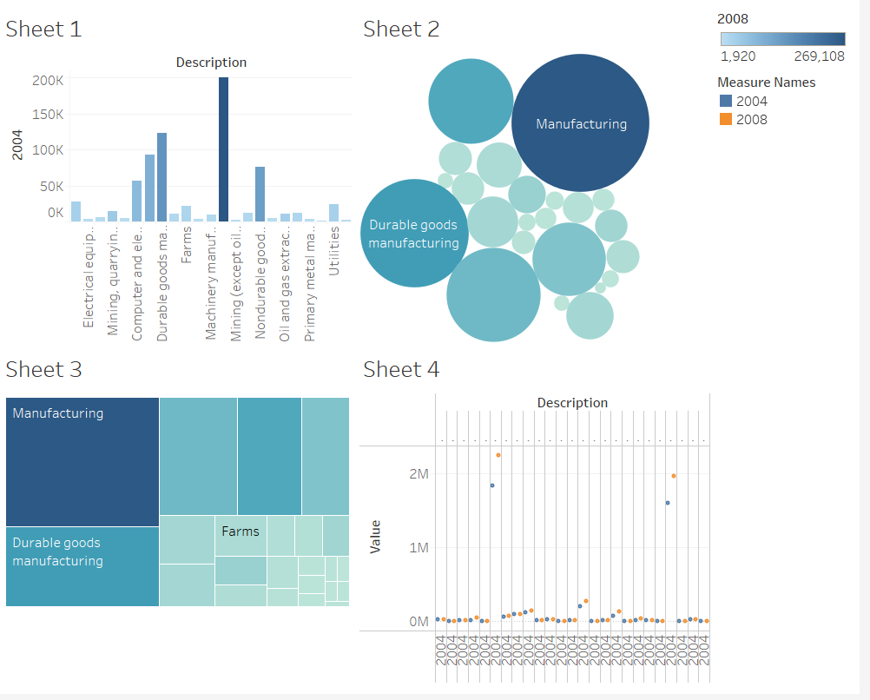
This is a dashboard in Tableau that consists of all the graphs made using the tool.

